Slide 1
2019 Subcontractor Safety Summit
Our Goal is to:
Partner together to strengthen relationships and consistently grow
the safety culture on
all Hagerman
projects.
Notes:
Change our goal to the survey information

Slide 2
Jeff Hagerman
Chairman of the Hagerman Group

Slide 3
A Sincere Thank You…
Our Vision of Building a Better Future applies to all elements of what we do.
The history of our success has been driven by strategic relationships who value safety and integrity.
Completing 80% of the work on our projects, you drive the safety culture and ultimately the success of our projects.
Looking forward…..we will always continue to strengthen our safety environment, but we need your help and commitment.
Thank you for being here today and thank you for all that you do to keep our industry safe!
Notes:
Jeff Hagerman
Our Vision of Building a Better Future applies to all elements of what we do.
The history of our success has been driven by strategic relationships who value safety and integrity.
Completing 80% of the work on our projects, you drive the safety culture and ultimately the success of our projects.
Looking forward…..we will always continue to strengthen our safety environment, but we need your help and commitment.
Thank you for being here today and thank you for all that you do to keep our industry safe!

Slide 4
Thomas White
Chief Safety Officer

Slide 5
Logistics
Emergency Exit
Elevator
Restrooms
Introductions, Thank you, Ice Breaker
Notes:
Thomas White

Slide 6
Happy Valentines Day!
Notes:
Thomas White
- Safety is an organizational and more importantly personal choice, not just for safety personnel, superintendents/foreman, or even employees for that matter, but for those that we love.

Slide 7
Objectives
Partner with your team to strengthen relationships and grow a positive safety culture on our projects.
Understand our vision for a growing safety culture and what role our subcontractors play in that goal.
Provide a legal perspective on current and upcoming safety topics
Two way street- ASK for a few things.
In return, we are going to offer a few things
Notes:
Thomas White

Slide 8
What and How
How our Subcontractors can help
Review Hagerman Safety Manual for scope of work
Be prepared
Communication
Attitude for Safety
How we would like to help you
It is a team effort
Meet the objective of safety performance
Notes:
Thomas White

Slide 9
Chad Baker
Director of Field Operations

Slide 10
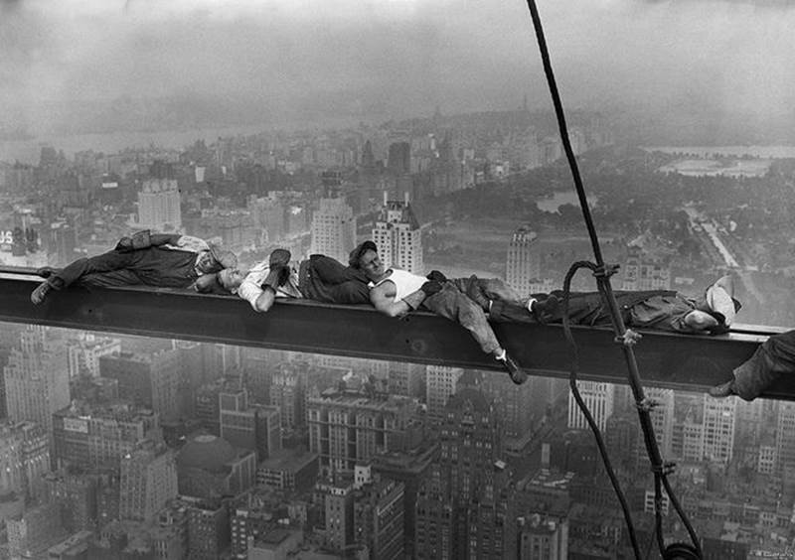
Field Operations Commitment to Safety
Notes:
Chad Baker
Began career with Hagerman 20 years ago when hard hat usage was probably the most common safety issue on our projects
Safety glasses were worn occasionally when cutting or grinding, hi-viz was only worn by highway workers, and fall protection was used when it was convenient
The industry, along with Hagerman’s safety culture has grown exponentially since then, especially in the past 10 years.
My definition of Hagerman’s safety culture: doing the right thing, regardless of who is paying attention. Also known as integrity
It began with a commitment from leadership- it is now one of our 9 core values within the company
The culture is led by our safety department and more importantly, executed through our field and office personnel.
Safety culture cannot succeed without continuous training. Hagerman Institute, our training platform, offers hundred of hours of safety training to our employees each year

Slide 11
When it comes to a safe, productive jobsite, it starts with planning
Notes:
Chad Baker
Safety orientation video- brief overview of our requirements
Jobsite specific orientation checklist
Pre-con safety meeting for high hazard scopes of work- critical the foreman is part of this meeting
If we plan ahead and do it right the first time, it does not cost more. We have experienced this with our self-perform work

Slide 12
We want our Subcontractors to be part of our team
Notes:
Chad Baker
Bring any issues up to our superintendent, regardless of who is responsible
We never want to hear that we are not holding our own employees, or other subcontractors accountable to the same level as you
Notify us, in advance, of any high hazard work that is coming up
Most of our larger projects has a weekly foreman’s meeting and this is great time to discuss these topics
If you are unsure whether it would be considered high risk work, just ask
Unlike other GC’s, we do not have a hands-off approach
We can help with:
Planning the work
Recognizing potential safety concerns or hazards
If we don’t have the answer, we have multiple industry contacts that are experts in their field

Slide 13
What Hagerman is asking of you
Notes:
Chad Baker
Preplanning- as discussed earlier
Do not approach the issue on the day of the activity and ask what needs to be done.
This may not allow for the appropriate materials and equipment to be onsite.
Your employees may not be trained properly
You may conflict with other trades work.
Communicate with your foremen
Biggest challenge is when our planning for a safe project does not make it to the guys actually performing the work
Daily Paperwork
Pre-task Plan
This is the best opportunity to make sure your workers are clear on the requirements and the risks.
You can use your form or we can provide one. Turn this in to our super at least each week.
Equipment Inspections
This need to be done daily for each piece of equipment.
Weekly Tool Box Talks
Other misc. inspections or permits, depending on the project
Scaffold inspections
Excavations
Lock out tag out
Burn Permits

Slide 14
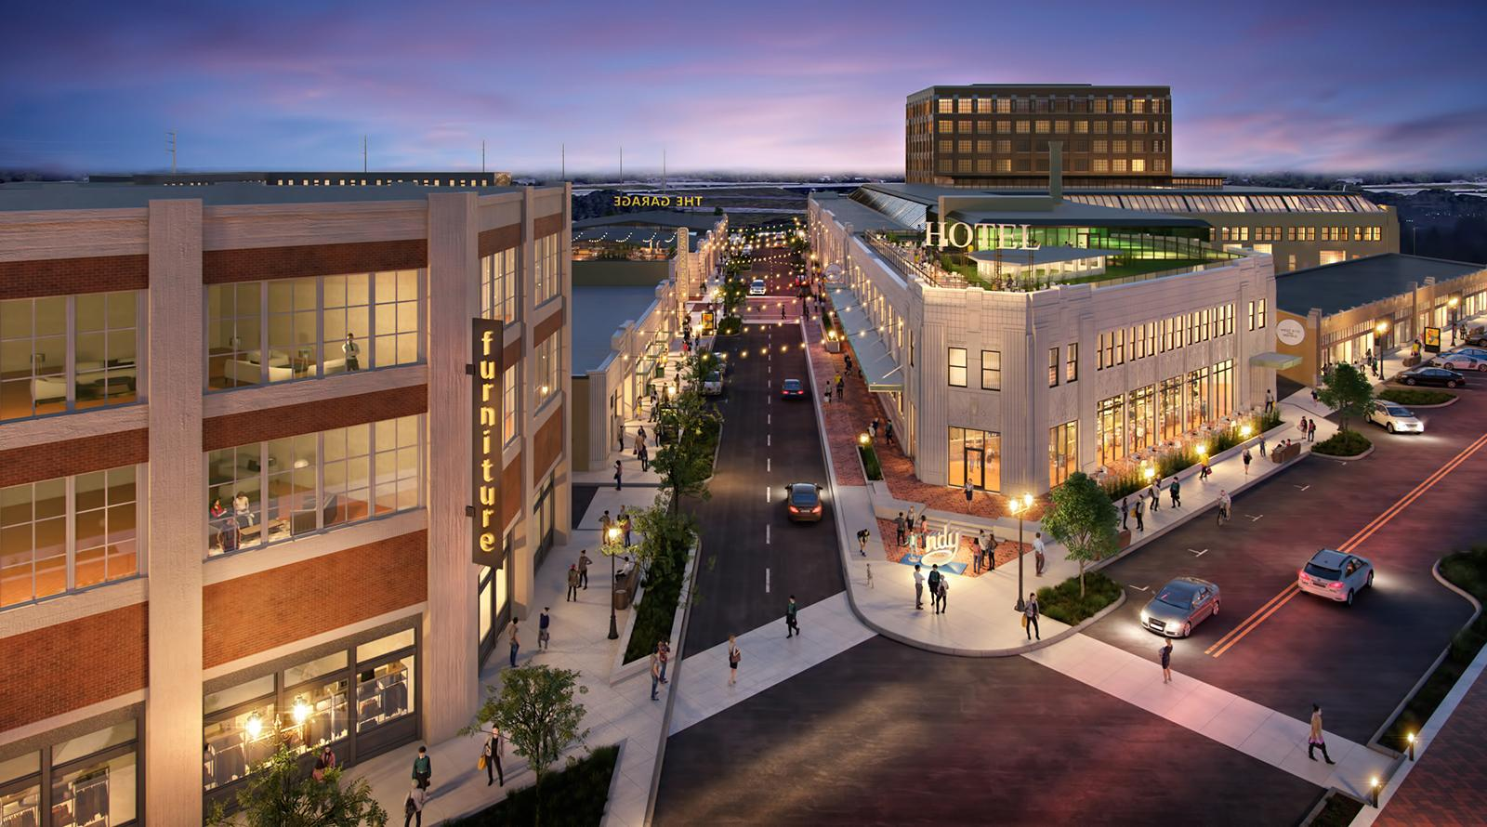
In closing..
Chad Baker
Director of Field Operations
cbaker@hagermangc.com
317.577.6836
Notes:
Chad Baker
We need your help as management, to provide the top down approach
Have clear expectations of your employees responsibility to meet the requirements
Help us with enforcement if it becomes necessary
Keep our requirements in mind during:
your preplanning
turnover processes
during your bid.
In turn, we will strive to create a consistent safety culture on all Hagerman projects
Questions??
Where would you like to see improvement from our field or office staff in regards to safety?
Do you feel that we hold our own employees to the same level as subcontractors?
Do you experience consistency of our safety culture across the different Hagerman projects?

Slide 15
Jeff Poynter
Area Safety Manager
Lakin Bowell
Safety Coordinator

Slide 16
Accessing our Safety Manual
In our contracts, we require all of our work to be performed to OSHA minimum standards and Hagerman Safety Policy.
Where can our manual be found?
www.thehagermangroup.com - “ABOUT” – “SAFETY” – “SAFETY MANUAL” – password is “safety”
In our office trailers/job boxes when you arrive on site
ProCore
Notes:
Lakin
We expect our subcontractors to have an understanding of what we expect from them on our projects. Our contracts include all OSHA standards and standards from the Hagerman Safety Program that may go above and beyond OSHA’s standards.

Slide 17
Safety on our Projects
Before mobilization we require:
Site Specific Safety Plans
Silica Exposure Control Plan
Documentation of training
Pre-Construction Meetings
Fishers Police Department
Notes:
Jeff
Before mobilization on site, all subcontractors have to submit a Site Specific Safety Plan, a Silica Exposure Control Plan and Documentation of Training
- Site specific safety plans spell out your approach towards your scope of work on site
- Your Silica Exposure Control Plan must follow table 1, or you must have IH measurements saying that you are below the PEL.
- Your documentation of training includes but is not limited to pieces of equipment (forklift, aerial lift, crane, etc.), confined spaces, scaffolding,
excavation, etc.
Before work begins on our projects, all employees on site have to go through a site safety orientation. This orientation consists of a 20-minute video, a hard copy of Hagerman’s policies that go above and beyond OSHA, and you will receive a hard-hat sticker.

Slide 18
Safety on our Projects
Site Safety Orientation
Daily Pre-Task Plans
Weekly Toolbox Talks
Incident Reporting and Review
St. Vincent Sim Center
Notes:
Jeff
Hagerman requires pre-construction meetings for all high hazard work including but not limited to:
Excavations, steel erection, roofing, masonry, and crane usage
Hagerman requires every contractor on site to fill out, go over and have their employees sign in on a daily pre-task plan. Toolbox talks should be conducted weekly and have a sign in sheet with them as well.
Ideally, we would like these documents to be submitted by your foreman on ProCore, but the superintendents may take hard copies as well.
All injuries, incidents near misses and property damages must be immediately reported to the Hagerman superintendent/ foreman and a thorough investigation will take place and a checklist will be completed.
This checklist includes:
Providing treatment to the injured employee
Taking the employee to the clinic, hospital, if need be.
Drive the employee to the clinic, or have a company representative drive the employee
Report the injury to the Hagerman Chief Safety Officer as soon as possible
Completing A Hagerman injury/incident/near miss/ property damage report
Have the employee/witness complete the employee/witness form
Attach a copy of the incident report, pre-task plan, witness form and clinic release form to an email and send it to Hagerman Safety.

Slide 19
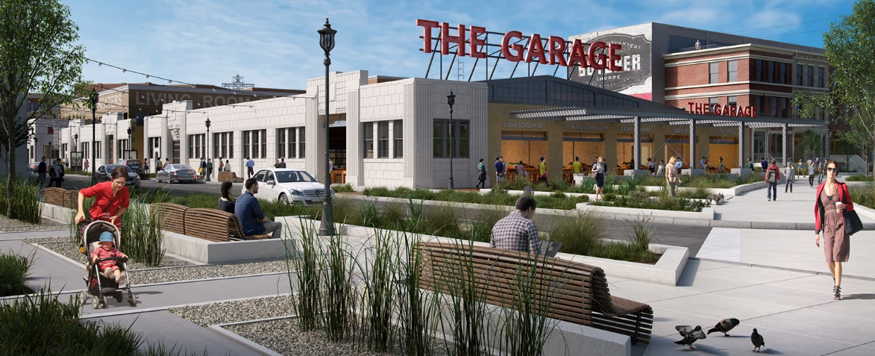
Hagerman Standards above OSHA
Minimum PPE required on all projects is: Hardhat, ANSI Z87 rated Safety Glasses, High Visibility Clothing worn on the torso, Boots, at least short sleeves on shirts and long pants.
Boom and scissor lifts require tie off unless the manufacturer specifically requires that workers in the lift not be tied off or secured (rare occurrences).
Fall protection is required for elevated work at 6ft or higher above a lower level for all trades. No exceptions for steel erection, scaffold work, excavations, precast concrete, etc.
Notes:
Lakin/Jeff

Slide 20
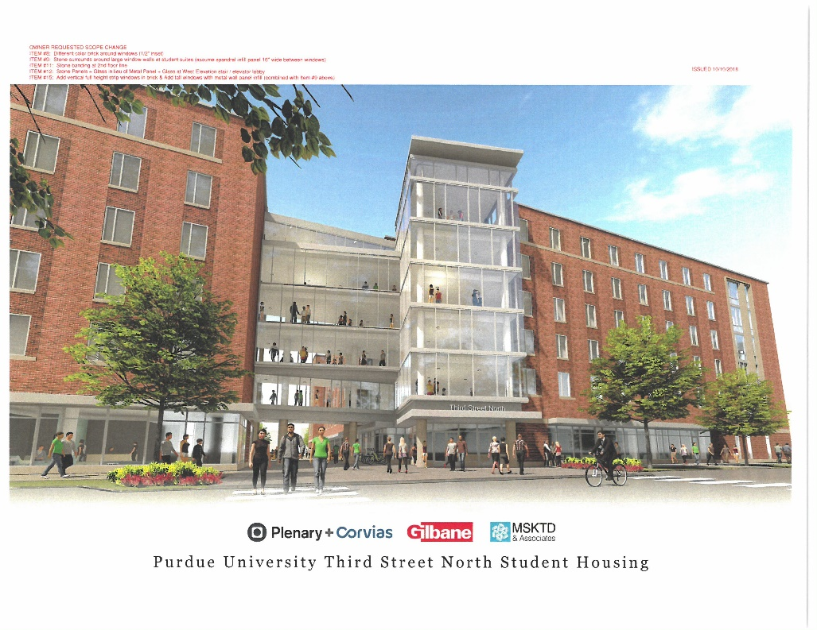
Hagerman Standards above OSHA
Excavations 6ft or greater in depth with vertical or near vertical sides need to be protected by standard guardrail or another form of fall protection.
Open excavations are required to be visually marked with caution tape, danger tape, pendant line, snow fencing or other means.
Safety monitors for fall protection are not permitted. Fall protection must be positive in nature.
All tower and lattice type crawler cranes owned, leased or operated on Hagerman Construction sites require a 3rd party inspection to be post assembly and prior to operation.
Notes:
Lakin/Jeff

Slide 21
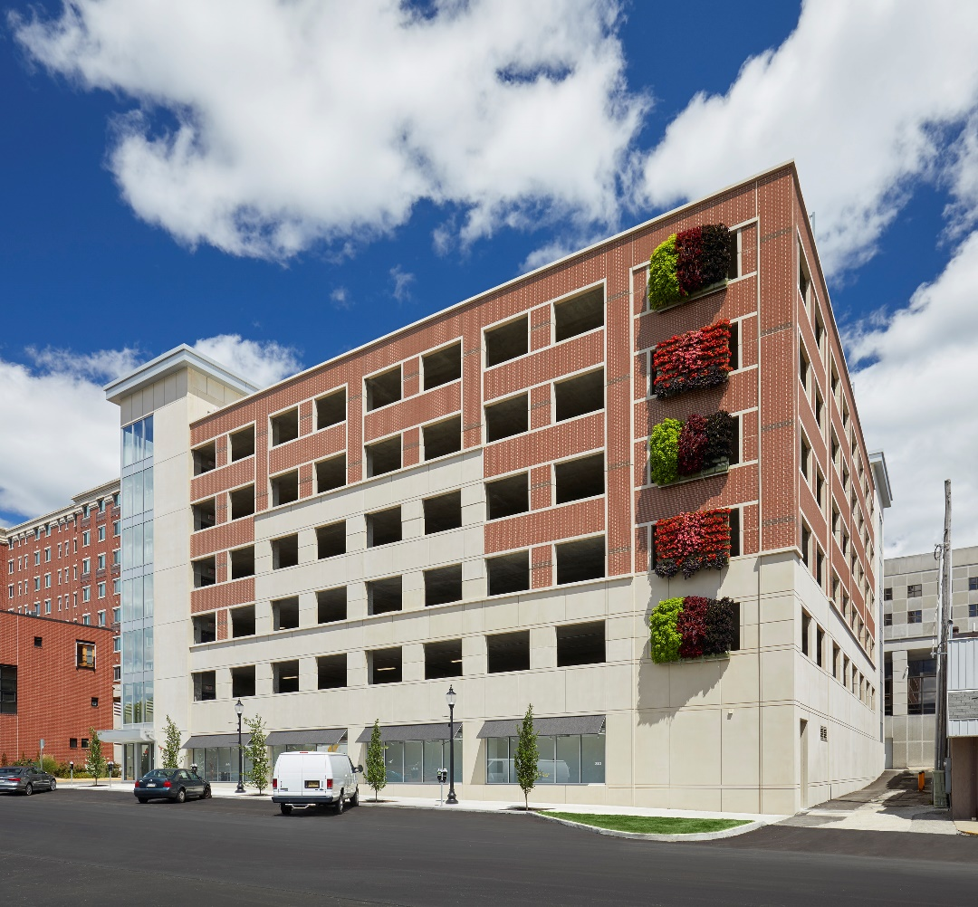
Hagerman Standards above OSHA
Critical lift plans must be submitted and approved prior to using if a pick will exceed 75% of the crane’s rated capacity as configured.
No Chinese or foreign manufactured hardware is allowed for personal fall protection or hoisting/rigging.
During masonry operations, the wall being constructed should be a minimum of 32” and scaffolds should be adjusted accordingly.
Notes:
Lakin/Jeff

Slide 22
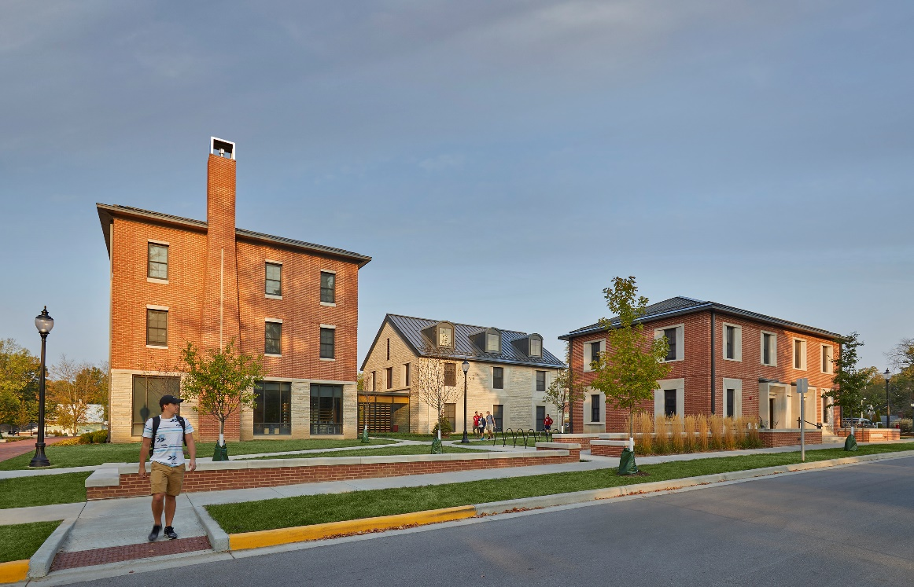
Hagerman Standards above OSHA
All operations near power lines must stay back at least 15’ without prior approval from Hagerman Safety Management.
Aluminum and manufactured wooden ladders are prohibited.
Ladders must meet a minimum of 300 lb. capacity.
Saw cutting or drilling operations where the employee or others may be exposed to silica must be engineered to prevent the hazard following Table 1.
Notes:
Lakin/Jeff

Slide 23
Partnering in the Success of Safety with our Project Teams
Partnership
Training
Use us as a resource
Notes:
Jeff

Slide 24
Hagerman Safety Culture Survey
Please go to sli.do on your phone, computer or tablet.
Enter the number “2350” in the box that says “Enter event code” and click join.
You will then be prompted to begin our survey.
1 star- strongly disagree, 5 stars- strongly agree
Notes:
Jeff/Lakin

Slide 25
BREAK
PLEASE RETURN BY 2:15pm

Slide 26
Adele L. Abrams
Esq., CMSP

Slide 27
Survey & Discussion
Notes:
Thomas White

Slide 28
Take out your Raffle Tickets
Notes:
Thomas White

Slide 29
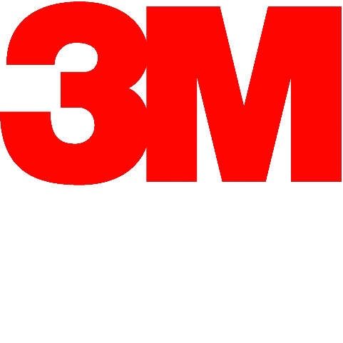
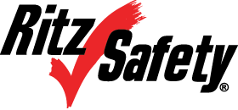
Thank You for Attending
Special thanks to our vendors…

